Slide 1
Tips on Algorithm Design Questions
With sample answers

Slide 2
General Strategies
Is the problem asking for a feasible solution or an optimal one?
Generally greedy solutions may be fine for feasible solutions.
But not necessarily for optimal ones (exceptions: prim’s, djikstra etc.)
Identify an analogous problem (if one exists):
Travelling Salesman, Knapsack, Graph Colouring, etc. etc.
Draw equivalences between the question and the problem’s attributes
What do the nodes represent, what do edges represent, what do colours represent, what are the knapsack items?
Identify an algorithm design pattern:
Tree search with backtracking, greedy, brute-force, divide-and-conquer, decrease-and-conquer, minimax, dynamic etc. etc.
Apply the algorithm design pattern:
When referring to ADTs (graphs, stacks, queues etc.) – you must link their attributes to the problem
What do nodes, edges (undirected, directed), weights, priorities represent in the problem?
Greedy: What is the heuristic you will use? How do you generate neighbouring nodes?
Tree search with backtrack: How do you generate neighbouring nodes? When do you backtrack?
Decrease-and-conquer: How do you decrease the solution space?
Divide-and-conquer: How do you divide the problem, and merge the sub-problems?
Dynamic: How do you build the problem bottom-up? What is the overlapping subproblems? What is the optimal substructure?

Slide 3
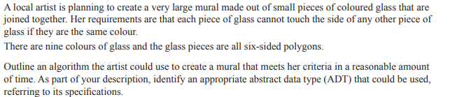
2017, Question 1

Slide 4
2017, Question 1
This is a graph colouring problem
Nodes are panes of glass
Undirected edges represent neighbouring glasses (6 edges) except for panes on the border
Apply a greedy algorithm design
Start with one node, colour it randomly.
Perform a depth first tree-search, colouring each neighbour with a different colour to the current node.
If no valid colours are applicable, backtrack and recolour nodes.

Slide 5
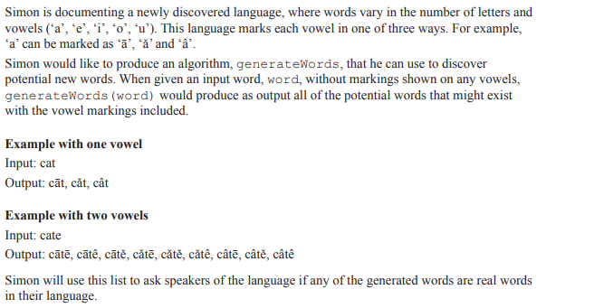
2017, Question 2a

Slide 6
2017, Question 2a
Tree-search.
Nodes are represent linear letter progressions through the word.
Leaf nodes represent the final word variations.
Directed edges represent each vowel variation branching from a vowel encountered.
For each vowel encountered, generate 3 child nodes, one for each vowel variation.
Time complexity: 3^{n} where n = number of vowels in the word

Slide 7
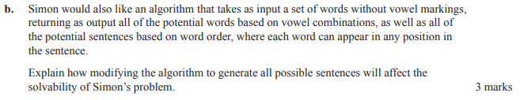
2017, Question 2b

Slide 8
2017, Question 2b
To generate all possible sentences, all possible permutations of the words must be considered
This gives a time complexity of m! where m = number of words
All the vowel possibilities must then be considered for each word permutation which gives a time complexity of m!3^{n} where m = number of words, and n = number of vowels in the sentence
This results in a combinatorial explosion making its running time infeasible for larger values of m or n.

Slide 9
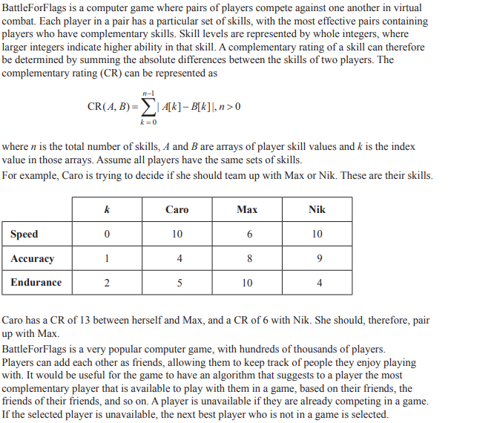

2017, Question 12a

Slide 10
2017, Question 12a
Additional condition: if a player is new, apply the CR algorithm for ‘n’ random players who are also new or with a low number of friends

Slide 11

2017, Question 12b

Slide 12
2017, Question 12b
Node are players, containing array of skills values
Undirected edges represent friendships between players
Starting from the adjacent friends from the player (or if new player, the list of ‘n’ players from previous answer)
Conduct a breadth-first-search to ‘m’ levels
Enqueue into a priority queue based on the CR score
Dequeue from the priority queue until an available player is selected

Slide 13

2017, Question 14a

Slide 14
2017, Question 14a
This is a variation of the TSP.
Nodes are destinations.
Undirected edges represent connections between the destinations, edge weights represent the shortest distances between the destinations.
Apply a greedy algorithm using a heuristic selecting the shortest immediate edge from the current node to traverse.
Mark each node visited to avoid revisiting the same location more than once.
Once all nodes are marked, traverse back to the depot node.

Slide 15
2017, Question 14b

Slide 16
2017, Question 14b
TSP brute force.
Generate all permutation of destinations, ending with the depot node.
Calculate the path costs for each permutation.
Selected the permutation with the minimum path cost.

Slide 17
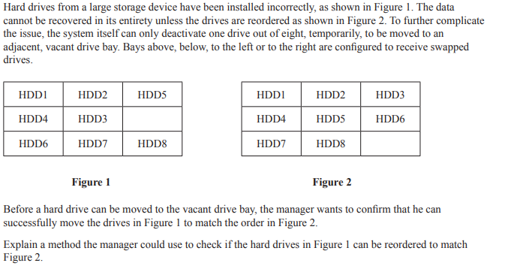
2017, Question 15

Slide 18
2017, Question 15
Tree search with backtracking.
Nodes represent the state of the HDD configuration.
Undirected edges represent neighbouring states reached by the sliding of a drive to a vacant drive bay.
From the initial node, generate all possible neighbouring states and connect via edges.
If a neighbouring state already exists, connect to this existing state.
Mark current node as seen
Traverse to any unseen neighbouring states in a depth first search manner.
If the traversed state matches the final state, then report that it is possible.
If there are no unseen neighbours, backtrack to last unseen neighbour.
If there no more unseen nodes, then report that it is not possible.

Slide 19
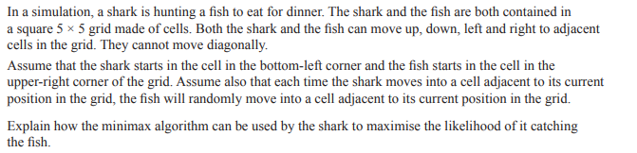
2017, Question 16

Slide 20
2017, Question 16 (Minimax is not ideal here!)
Heuristic is a score: 1.0 representing shark is on the same cell as the fish, 0.0 everywhere else
Nodes represent the 5 x 5 board
Directed Edges represent possible moves from each board leading to another board
There are a maximum of 4 outgoing edges from each node (up, down, left, right)
Each board may have more than 1 incoming edge as states can be revisited
Score all boards according to the heuristic and recursively backtrack to the current state
When it’s the shark’s turn choose the edge which maximises the score
When it’s the fish’s turn, randomly selects an outgoing state

Slide 21
2017, Question 16 (Greedy Tree Search)
Heuristic score: dx + dy
where dx = abs(shark_{x} – fish_{x}), dy = abs(shark_{y} – fish_{y})
Nodes represent the 5 x 5 board
Directed Edges represent possible moves from each board leading to another board
There are a maximum of 4 outgoing edges from each node each representing a valid move (up, down, left, right)
At the current node, generate and score the 4 x neighbouring boards
If it’s the shark’s turn transition to the node with the maximum score
When it’s the fish’s turn, transition to a randomly selected node

Slide 22
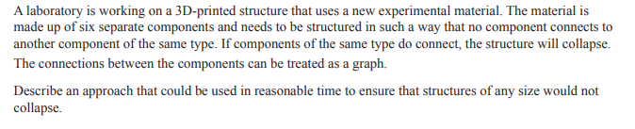
2016, Question 2

Slide 23
2016, Question 2
This is a graph colouring problem
A node represents a component
The node’s color represents the type of components, 6 possible colours
Undirected edges represent connections between components
Apply a greedy algorithm design
Start with one node, colour it randomly, then colour all its neighbours with a different colour
Perform a depth first tree-search, colouring each neighbour with a different colour to the current node.
If there are no more valid colours to choose from, backtrack and recolour the last coloured node with the next valid colour

Slide 24
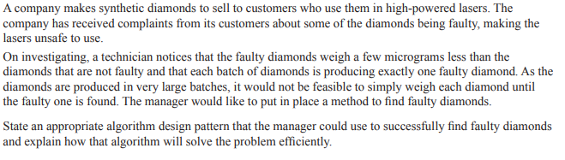
2016, Question 3

Slide 25
2016, Question 3
Apply a decrease-and-conquer design pattern
Divide the batch into 2 and weight both halves
Disregard the heavier batch (as it will not contain the faulty, lighter diamond)
With the lighter half, recursively divide into 2, selecting the lighter half for weighing until only 1 diamond remains.
This is will be the faulty diamond.
Time Complexity: O(log n)

Slide 26
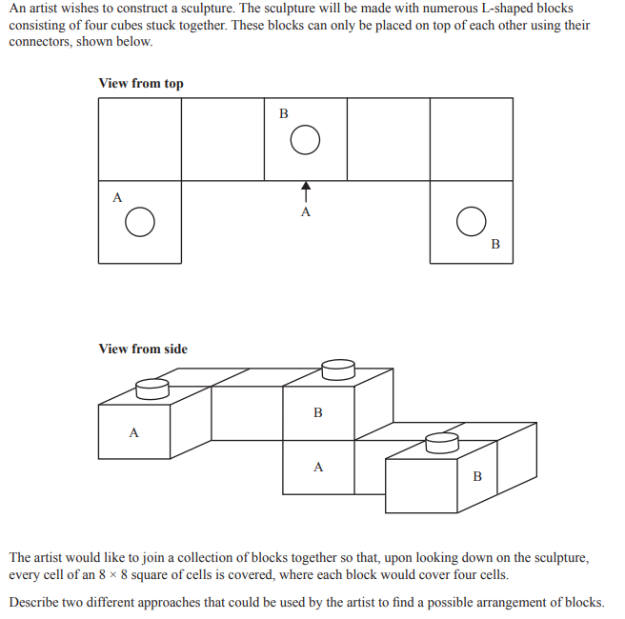
2016, Question 8

Slide 27
2016, Question 8
Approach 1:
Tree search with backtracking
Nodes represent configuration of blocks
Directed edges represent addition of new block leading to a new configuration
Recursively generate all possible configurations from current node by adding a new block at all possible connectors and at all possible orientations
Traverse in a DFS manner
Check that configuration covers all 8x8 squares from the top perspective, if so, this is a solution
If the configuration doesn’t cover any additional squares and the most recently added block is already positioned and oriented in the same way previously, backtrack to the most recent unexplored configuration
If the configuration is invalid (ie. exceeds an 8x8 square) backtrack to the most recently unexplored configuration

Slide 28
2016, Question 8 (cont.)
Approach 2:
(Divide and conquer??)

Slide 29
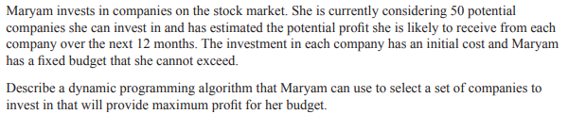
2018, Question 5

Slide 30
2018, Question 5
A variation of the knapsack problem
Lowest cost increment is equivalent to knapsack weight increment
Each investment is equivalent to a knapsack item
Initial cost of company investment is equivalent to weight of item
Profit of company investment is equivalent to the value of the time
Maryam’s fixed budged is equivalent to the knapsack capacity
Max(profit for current cost, profit of current investment + profit for (cost – cost of current investment))

Slide 31
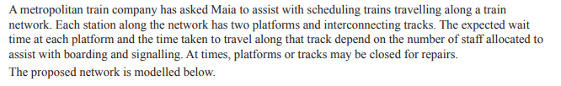
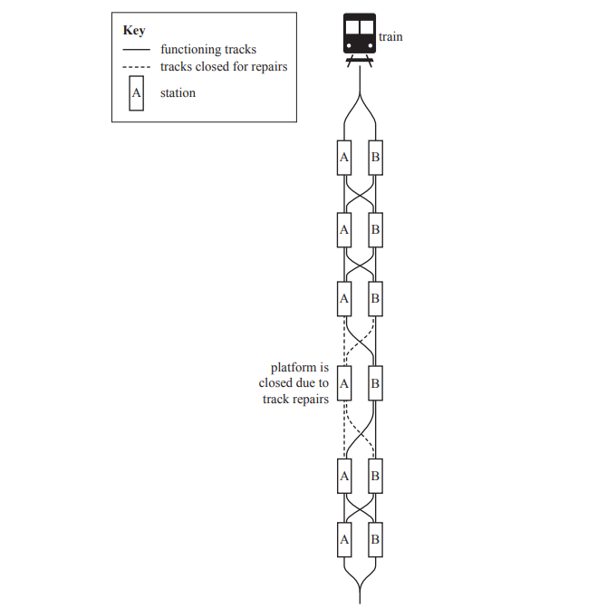

2019, Question 6b

Slide 32
2019, Question 6b
Overlapping subproblems:
The most efficient schedule for a network with ‘n’ connections will contain within it, the most efficient schedule for a network with fewer than ‘n’ connections.
Optimal substructure:
The most efficient schedule for a network with ‘n’ connections will be the maximum of the most efficient schedule with ‘n – m’ connections where each m represents an incoming connection to the current station

